Slide 1
.NET Application Frameworks
Lunch & Learn – June 28, 2023 Matt Gallant

Slide 2
ASP.NET Core

Slide 3
ASP.NET Core
Modern application framework for Web
Continues support for MVC, Razor Pages, and WebAPIs
No WebForms though
Design builds on the learnings of the “OWIN” initiatives
A framework constructed out of a pluggable pipeline of middleware, decoupled from the web server
ASP.NET Core includes custom web server called “Kestrel”
Optionally, still host under IIS or on top of HttpListener (or other OWN-compatible server / host)
“Modern” all the things: these days supports HTTP/2 and HTTP/3 and QUIC, gRPC, a refreshed version of SignalR for those RTC scenarios
ASP.NET Core 6 introduced “Minimal API”s
Recent addition to the family is YARP (Yet Another Reverse Proxy)

Slide 4
Minimal APIs
Minimal APIs are a simplified approach for building fast HTTP APIs as an alternative to Controller-based APIs (though technically they could be mixed)
Minimal APIs are architected to create HTTP APIs with minimal dependencies. They are ideal for microservices and apps that want to include only the minimum files, features, and dependencies in ASP.NET Core. i.e. features are “pay-for-play.”
var builder = WebApplication.CreateBuilder(args);
/* register stuff */
var app = builder.Build();
app.MapGet("/", () => "Hello World!");
app.MapGet("/users/{userId}/books/{bookId}",
(int userId, int bookId) => $"The user id is {userId} and book id is {bookId}");
app.Run();
Source: https://learn.microsoft.com/en-us/aspnet/core/fundamentals/minimal-apis/overview
Notes:
Demo: 03-MinimalAPI
Point out Endpoints Explorer window
*.http request file

Slide 5
SignalR
ASP.NET Core SignalR is an open-source library that simplifies adding real-time web functionality to apps. Real-time web functionality enables server-side code to push content to clients instantly.
SignalR uses hubs to communicate between clients and servers.
SignalR Hub Protocol operates over WebSockets, Server-Sent Events, or Long Polling (auto-negotiated between individual client and the server)
Multiple client libraries available (.NET, Java, JavaScript)
Good candidates for SignalR:
Apps that require high frequency updates from the server. Examples are gaming, social networks, voting, auction, maps, and GPS apps.
Dashboards and monitoring apps. Examples include company dashboards, instant sales updates, or travel alerts.
Collaborative apps. Whiteboard apps and team meeting software are examples of collaborative apps.
Apps that require notifications. Social networks, email, chat, games, travel alerts, and many other apps use notifications.
Source: https://learn.microsoft.com/en-us/aspnet/core/signalr/introduction
Notes:
Samples: https://github.com/aspnet/SignalR-samples
DEMO: 04-ChatSample (taken from the sample repo and modernized to .NET 7)
Podcasts app
Hub: C:\Work\demo\dotnet-podcasts\src\Services\ListenTogether\ListenTogether.Hub\Hubs\ListenTogetherHub.cs
Hub Client (.NET): C:\Work\demo\dotnet-podcasts\src\Web\Components\ListenTogetherHubClient.cs

Slide 6
gRPC
gRPC is a language agnostic, high-performance Remote Procedure Call (RPC) framework.
The main benefits of gRPC are:
Modern, high-performance, lightweight RPC framework.
Contract-first API development, using Protocol Buffers by default, allowing for language agnostic implementations.
Reduced network usage with Protobuf binary serialization.
Tooling available for many languages to generate strongly-typed servers and clients.
Supports client, server, and bi-directional streaming calls over long-lived connection.
These benefits make gRPC ideal for:
Lightweight microservices where efficiency is critical.
Polyglot systems where multiple languages are required for development.
Point-to-point real-time services that need to handle streaming requests or responses.
Does however require at least HTTP/2… an issue today for JS in the browser
gRPC-Web and gRPC JSON Transcoding can mitigate some of the limitations for down-level clients (i.e. browsers)
Source: https://learn.microsoft.com/en-us/aspnet/core/grpc/
Notes:
Compare gRPC services with HTTP APIs : https://learn.microsoft.com/en-us/aspnet/core/grpc/comparison

Slide 7
Blazor
“Web without the JavaScript”

Slide 8
Blazor
Elevator pitch: For the web dev minded, a component-based UI and single-page application (SPA) framework for building apps using web technologies
Very similar conceptually to Angular, Vue, and other such frameworks
Just now, without having to write JavaScript… use C# instead!
Reuse your existing .NET business logic and the like, too.
Note: JavaScript isn’t outlawed… there is a two-way interop mechanism ☺
For UI, components are written in Razor syntax which is a hybrid of HTML markup with embedded C# for “programmability”
Coming (.NET 8?) – work being done to allow you to ditch the UI layer with and just use the “raw” .NET-to-JS interop.

Slide 9
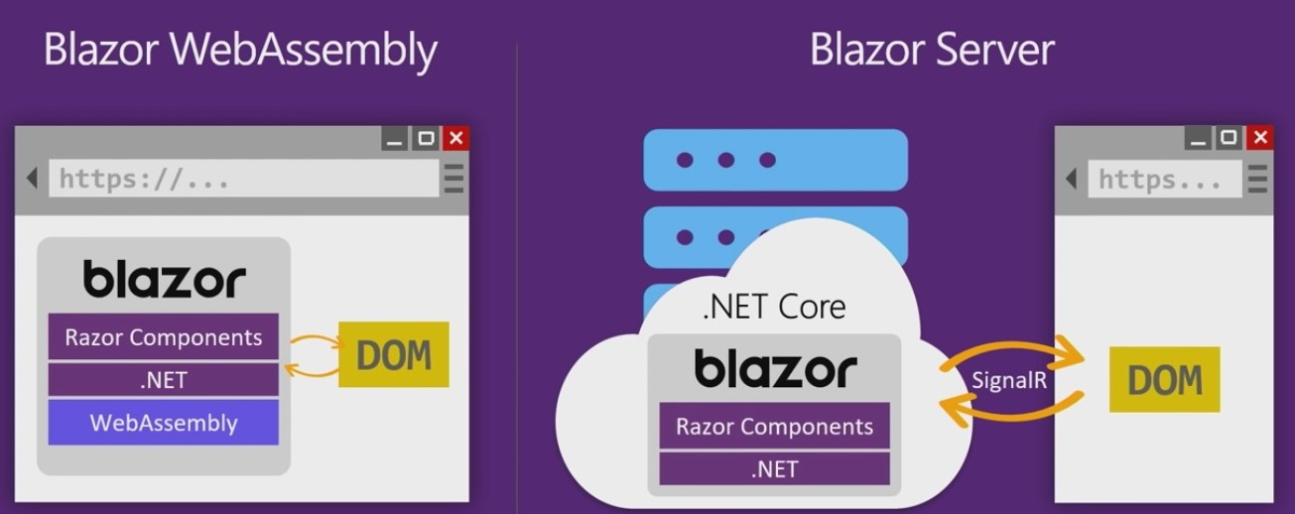
Blazor “Flavors”
Blazor Server
Code is hosted on the server
The starting page of the application references a bit of bootstrap JavaScript which is responsible for establishing a SignalR connection
The code on the client and server will communicate over the SignalR connection. Most of the work is done on the backend. In general, input is sent to up to the server for processing, the server pushes UI updates for the client side to apply to the DOM.
2. Blazor WebAssembly
SPA-like experience where everything runs inside the browser. Server is used as a repository for the necessary application files, and perhaps some backend APIs.
A version of the CLR (based on Mono) compiled to WebAssembly (WASM) is downloaded to support .NET code
DLLs downloaded and run “in the browser” on top of WebAssembly using the Mono runtime
The code is still subject to the confines of the browser security sandbox
3. Blazor “Hybrid”
The ability to take your application out of the browser (and its sandbox) as a “Progressive Web App” running directly on the OS.
WebAssembly runtime not used; your DLLs run natively on whichever .NET
HTML-based UI effectively runs in a hosted WebView offered by the platform.
Notes:
DEMO: 06-Blazor

Slide 10
.NET MAUI
Multi-platform App UI

Slide 11
.NET MAUI (Multi-platform App UI)
Evolution of Xamarin Forms for mobile development on Android and iOS
But MAUI adds desktop support (for Windows and MacOS) as well
Provides a common abstraction and XAML “flavor” to develop a single app sharing a lot of code across all platforms, customizing only when necessary
Under the covers on each platform the native platform is highly leveraged to provide the actual implementation
It’s possible to also develop against the native platform layer as well.
Results in your application a “native” feel. An iOS app feels like iOS, etc.
BlazorWebView control allows you to incorporate Blazor components in the app as well (“MAUI Blazor”)

Slide 12
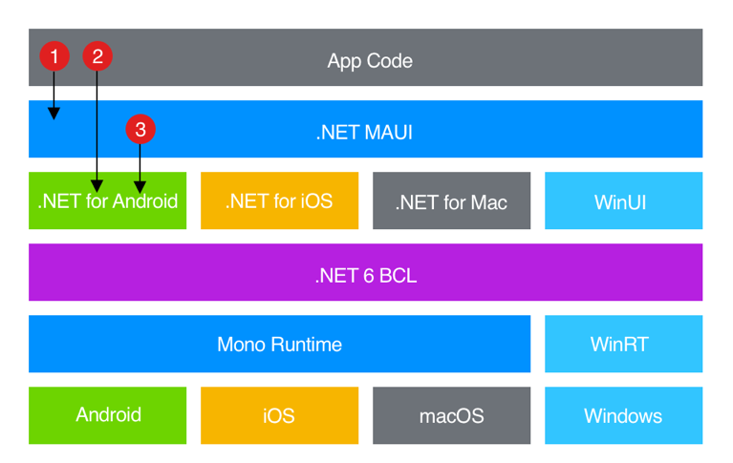
.NET MAUI layering
Source: https://codemag.com/Article/Image/2111092/image4.png

